Slide 1

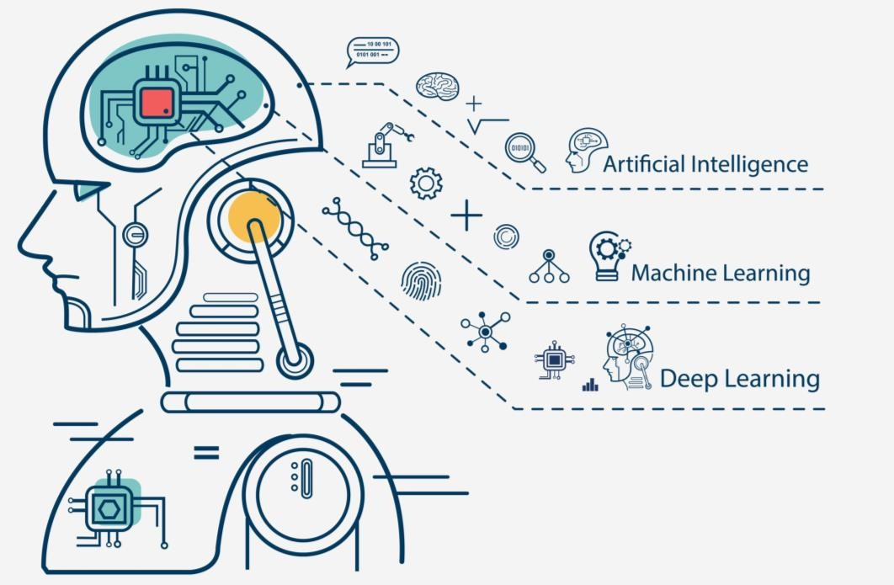





MACHINE LEARNING USING PYTHON

Slide 2
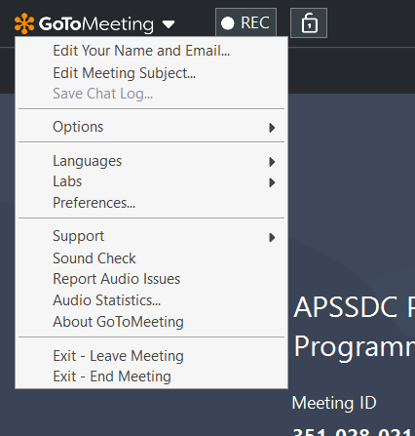

For Attendance and Verification Purpose
RollNo-Name- CollegeCode/ CollegeName
And RegisteredEmail
ID

Slide 3
SESSION RESOURCES
http://bit.ly/apssdc-ml-eb7

Slide 4
MACHINE LEARNING USING PYTHON AGENDA
Introduction
to Machine
Polynomial
Regression
Classification
models - 2
Dimensionality
Reduction
Linear Regression in Machine Learning
Classification models - 1
Unsupervised Learning and Clustering

Slide 5

DAY1 AGENDA
What is Machine Learning
Machine Learning Classification
Data Importing and manipulating
Types of
Algorithms

Slide 6
WHY ARE YOU ATTENDING THIS TRAINING PROGRAM
AI → ML, DL
It is use future
I wanted be an ML engineer
it is most trending in the today industry...so iam very much intreasted in it sir
To get Knowledge In fields Of AI and ML to became Data Scientist
It's the booming technology and machine learning is an interesting concept
I am more interested to learn how to a machine will learn!
Everybody saying AI and ML are very important. I want to know whats inside it
It is booming technlogy,so i want to acquire knowledge in ml and data analysis
i wnat to become a data scientist so ml is a part of DS thats why i am intrested to lear ml

Slide 7
WHERE ML IS USING
google voice Virtual assistans
online shopping websites/ social media platforms
Speech recognition or image recognition
weather prediction
Spam Email detection
YouTube recommendations
All types of automations
In medical field
Self driving vehicles, I think self driving vehicles comes under IoT???
search engine result refining
recognizing faces in google photos
bussinuss field
In space study
Health Care, Retail sector and Banking

Slide 8
PREREQUISITES
Python Programming
–Jupyter Notebook Environment
Data Analysis Concepts:
–Data Manipulation using NumPy
–Data Analysis using Pandas
–Data Visualizations using Matplotlib & Seaborn
–Data Preprocessing techniques using Sklearn

Slide 9
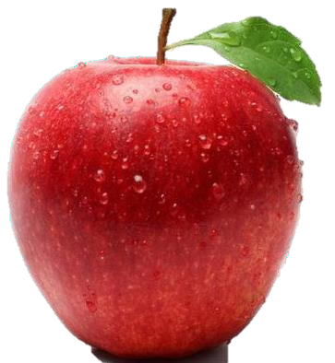

WHAT IS THIS FRUIT?
APPLE/Fruit
Color, Shape, Seeing, Smell, eating,Weight
Red, Heart Symbol, 150grms – 500grms

Slide 10
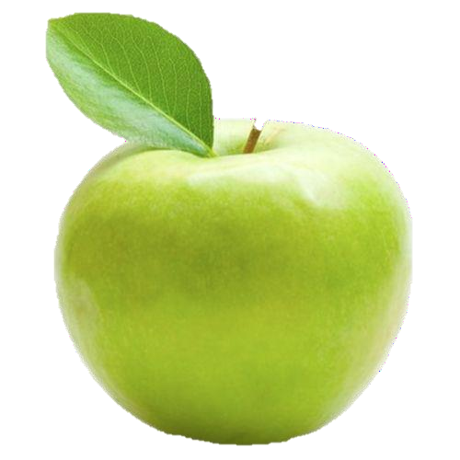
WHAT IS THIS FRUIT?
APPLE/Fruit
Color, Shape, Seeing, Smell, eating,Weight
Green, Heart Symbol, 150grms – 500grms

Slide 11

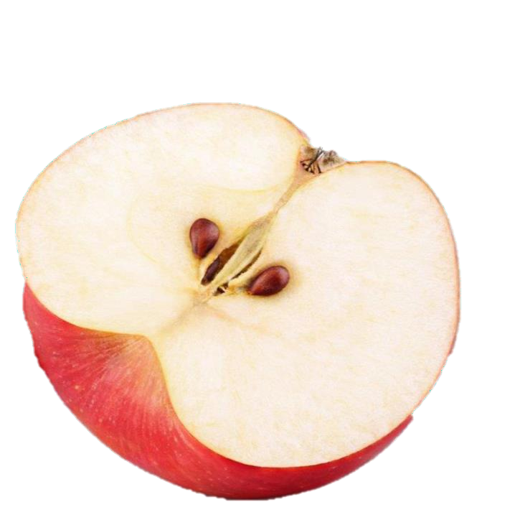
WHAT IS THIS FRUIT?
Apple, Half Apple
Color, Shape, Seeing, Smell, eating,Weight
Red, Heart Symbol, 150grms – 500grms
Seeds, Inner Color, Seed Location
Small,White, Center

Slide 12
QUIZ
Color | Shape | Weight | Size | What is it?
Red | Heart Symbol | 100grms | 2.5”
Red | Heart Symbol | 18grms | 1.375”
Green | Heart Symbol | 150grms | 2.7”
Red | Heart Symbol | 223grms | 3.25”

Slide 13
QUIZ
Color | Shape | Weight | Size | What you can do?
Red | Heart Symbol | 100grms | 2.5”
Red | Heart Symbol | 18grms | 1.375”
Green | Heart Symbol | 150grms | 2.7”
Orange | Circle | 223grms | 3.25”
green | curved | 75grms | 3”
Orange | Oval | 150grms | 3.5”
green | circular | 80grms | 2.5”
red | oval | 550grms | 5”
green | circular | 5grams | 0.5”
red | oval | 50grms | 2”

Slide 14
QUIZ
Color | Shape | Weight | Size | What is it?
Red | Heart Symbol | 10000 grms | 2.5” | APPLE

Slide 15

WHAT MACHINE LEARNING ?

Slide 16
“A computer program is said to learn from experience(input data) E with respect to some class of tasks(Target) T and performance measure P, if its performance at tasks in T, as measured by P, improves with experience E.”
— Tom Mitchell, Professor at Carnegie Mellon University

Slide 17
Computer Program → Past Experience(Data) → W. r. to Some task T → with perromance P
P → T →E

Slide 18

WHAT IS ARTIFICIAL INTELLIGENCE, MACHINE LEARNING AND DEEP LEARNING

Slide 19
ARTIFICIAL INTELLIGENCE
Artificial Intelligence (AI) is the science of making things smart. Can be defined as:
“Human intelligence exhibited by machines”
A broad term for getting computers to perform human tasks. The scope of AI is disputed and constantly changing over time.

Slide 20
AI: COMMON USE CASES
Object recognition
Speech recognition / Sound detection
Natural Language Processing / Sentiment analysis
Creative (e.g. Style Transfer – Learning to draw an image in the style of an artist)
Prediction – given some inputs, what is the expected output for unseen examples
Translation between languages
Restoration / Transformation – e.g. taking an image and using ML to figure out what should be there, or generating faces based on what it knows face to be.
Some AI Examples

Slide 21
MACHINE LEARNING
Machine Learning (ML) can be defined generally as:
“An approach to achieve AI through systems that can learn
from experience to find patterns in a set of data”
ML involves teaching a computer to recognize patterns by example, rather than programming it with specific rules. These patterns can be found within data. In other words, ML is about creating algorithms (or a set of rules) that learn complex functions (or patterns) from data and make predictions on it –a form of “narrow AI”

Slide 22
DEEP LEARNING
Deep Learning (DL from here on) can be defined generally as:
“A technique for implementing Machine Learning”
One such DL technique is a concept known as deep learning Neural networks (DNNs) which you may have heard of.
Essentially DL in the context of DNNs is where the code structures you write are arranged in the layers that loosely mimic the human brain, learning patterns of patterns.

Slide 23
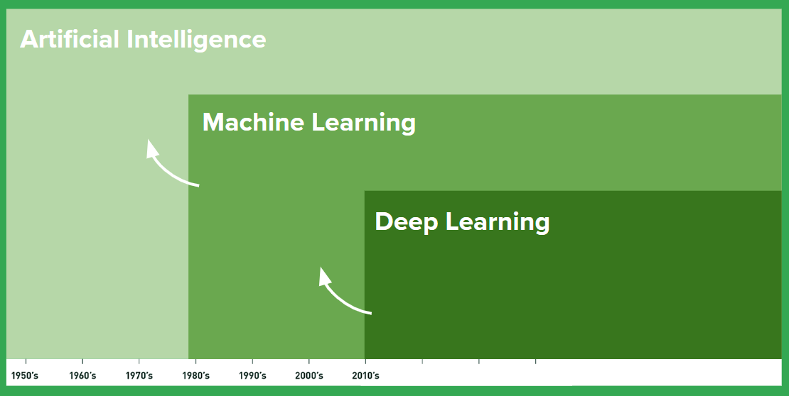
SUMMARY

Slide 24
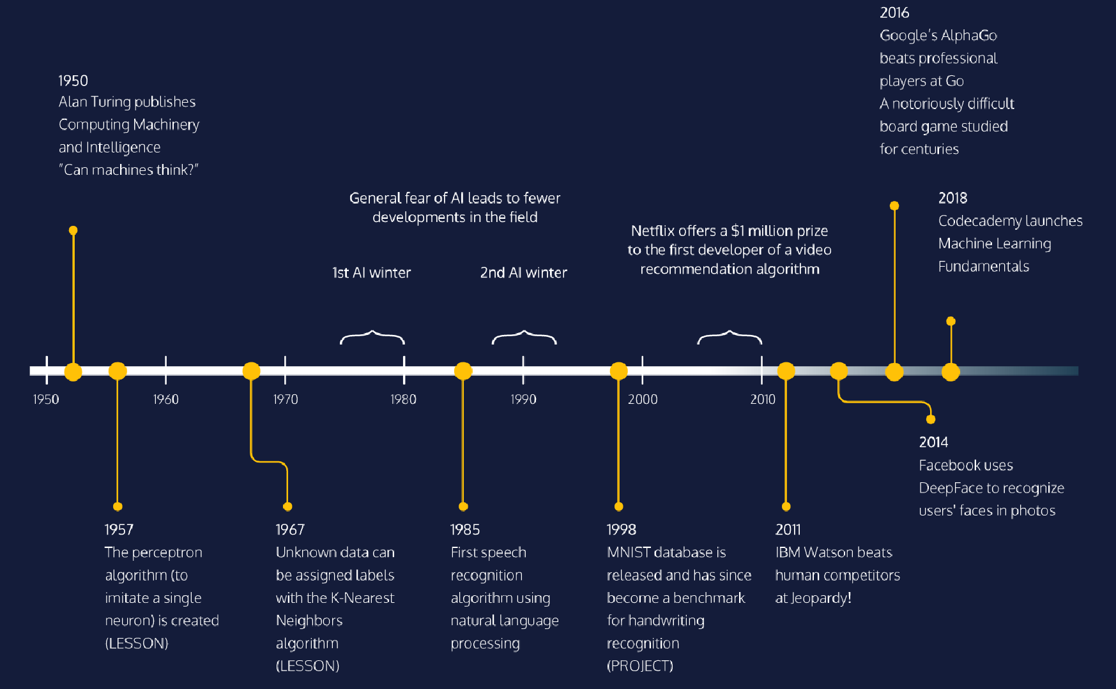

Slide 25
FEW OTHER DEFINITIONS
“Machine learning is the hot new thing”
— John L. Hennessy, President of Stanford (2000–2016)
“A breakthrough in machine learning would be worth ten Microsoft”
— Bill Gates, Microsoft Co-Founder
“Machine learning is the field of study that gives computers the ability to learn without being explicitly programmed”
— Arthur Samuel's

Slide 26
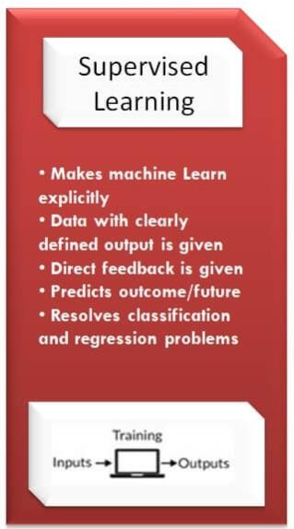
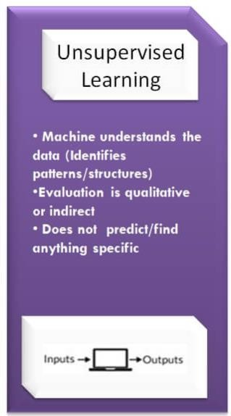
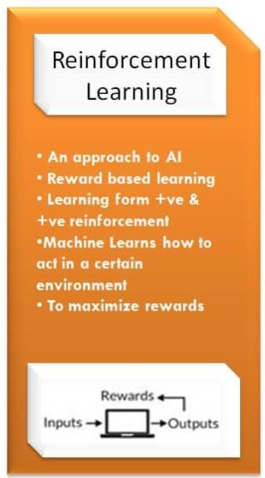
MACHINE LEARNING TYPES

Slide 27
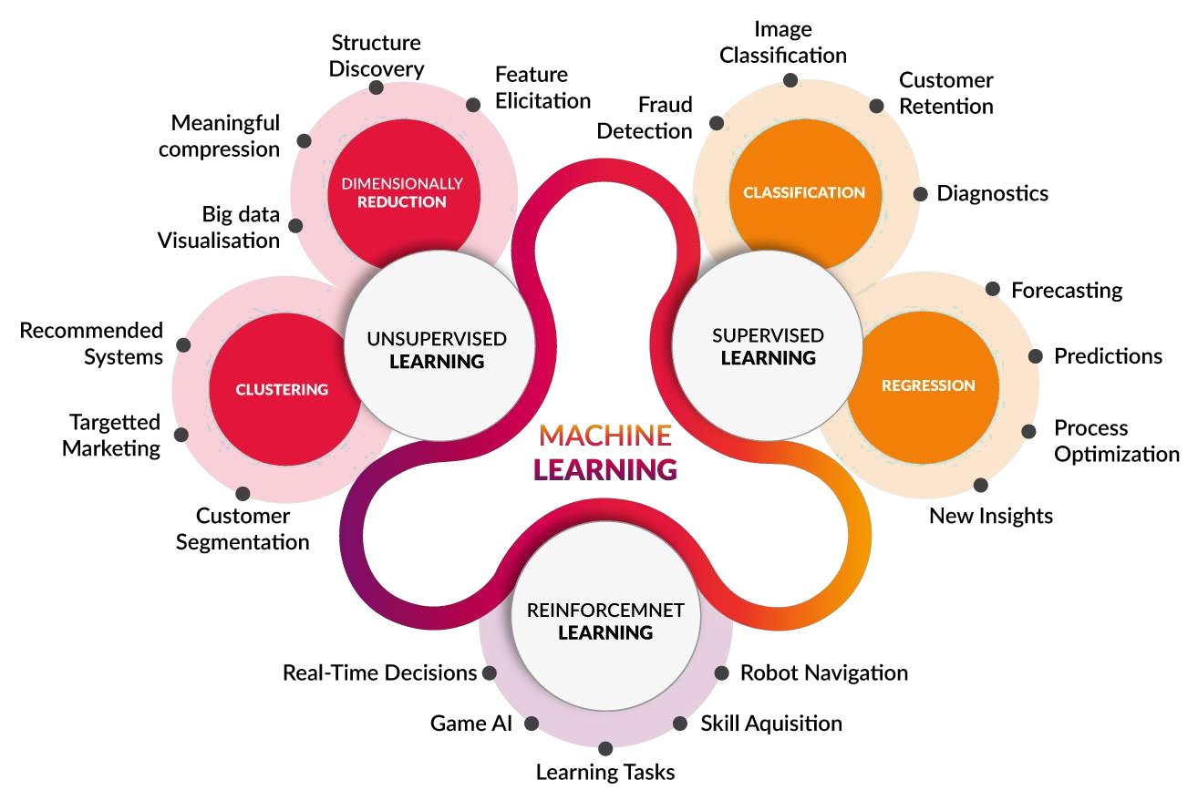
MACHINE LEARNING CATEGORIES

Slide 28
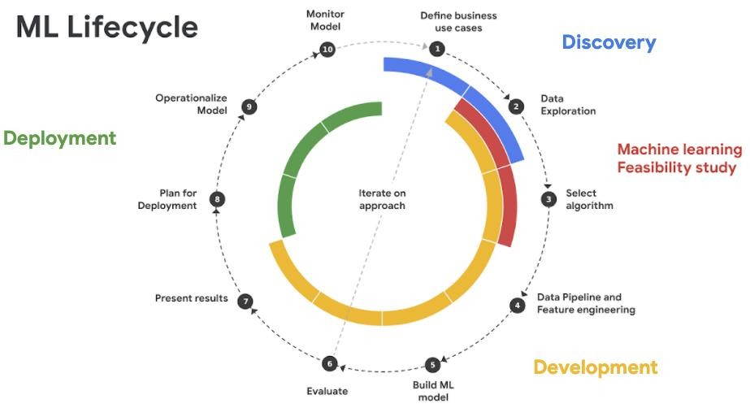

Slide 29
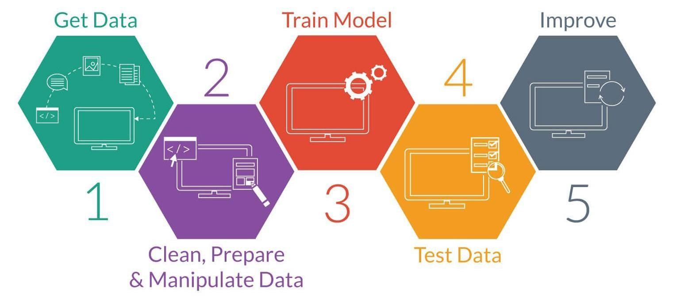
MACHINE LEARNING PROCESS

Slide 30
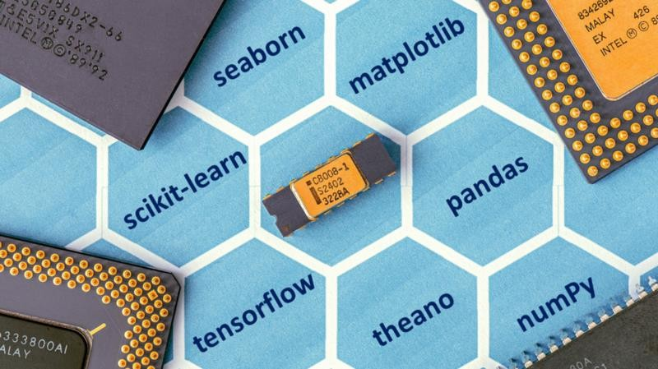
PACKAGES FOR ML IN PYTHON
By Anil Kumar APSSDC

Slide 31
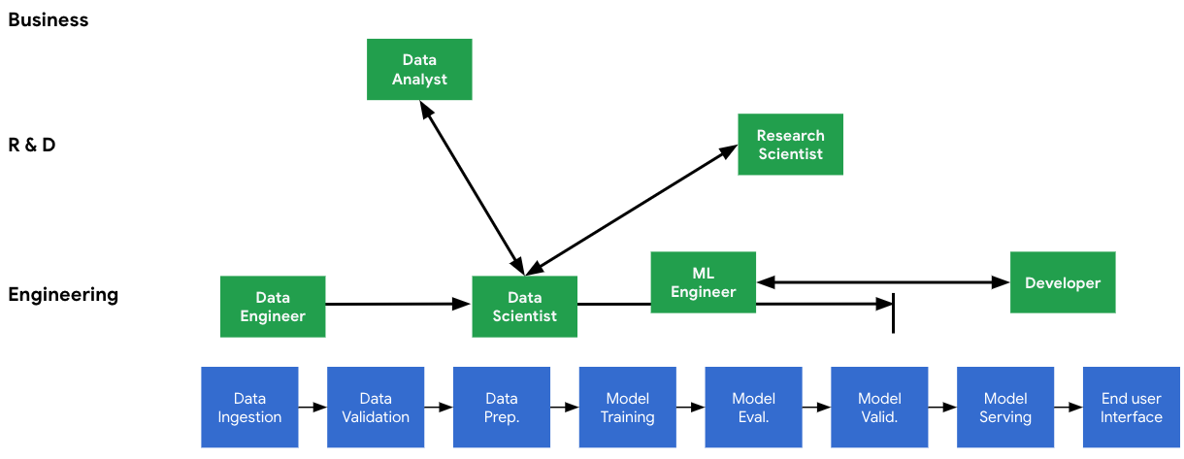
THE NEED FOR MACHINE LEARNING DESIGN PATTERNS

Slide 32
HOW TO CHOOSE DATA TO TRAIN THE
MODEL

Slide 33
DATA CLASSIFICATION IN REAL WORLD
Labeled, non labeled → Data
Categorical, Numerical → stastics
Structures → If data is having structure → CSV, Excel, DB, HTML Tables,TSV,
Semi-structured, → XML, JSON, … = {‘Key”: “Value”}
Unstructured → Text Files, PPT,Video, Images,Word, Audio,

Slide 34
Def ML
AI, ML, DL
Classification of ML
Life Cycle of ML
Classification real world data

Slide 35
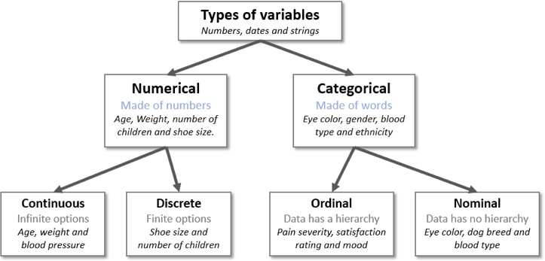
TYPES OF VARIABLES
https://en.wikipedia.org/wiki/Statistical_data_type

Slide 36
CLASSICAL PROGRAMMING VS MACHINE LEARNING
Data
Classical
Programming
Answers
Rules
Data
Machine Learning
Rules
Answers

Slide 37
CLASSICAL PROGRAMMING VS MACHINE LEARNING
data
Classical
Programming
ans
rul
data
Machine Learning
rule
ans

Slide 38
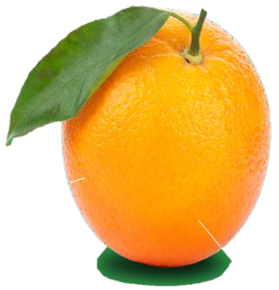
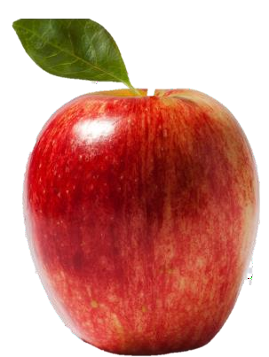
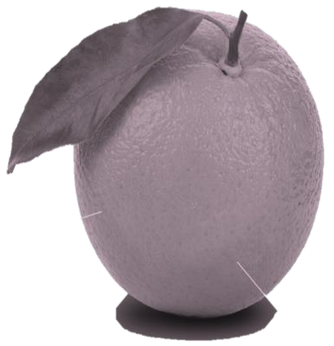
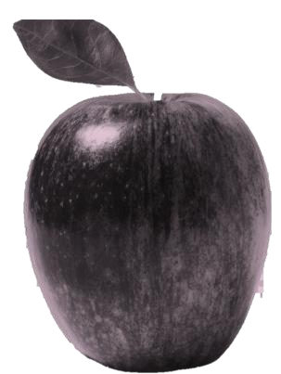
FEATURES / ATTRIBUTES
Features (aka attributes) are used to train an ML system. They are the properties of the things you are trying to learn about.

Slide 39
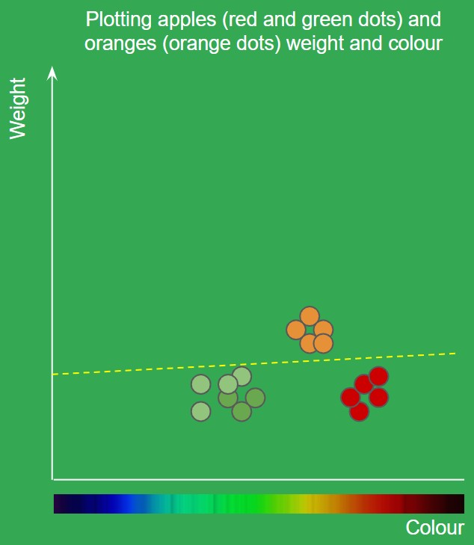
FEATURES / ATTRIBUTES
Taking fruit as an example. Features of a fruit might be weight and color. 2 features, would mean there are 2 dimensions. A 2D system may be plotted on a graph if features are represented in a numerical way.
In the plot on the right, the ML system can learn to split the data up with a line to separate apples from oranges. This can now be used to make future classifications when we plot new points the system has not seen (anything above is orange, below is apple)

Slide 40
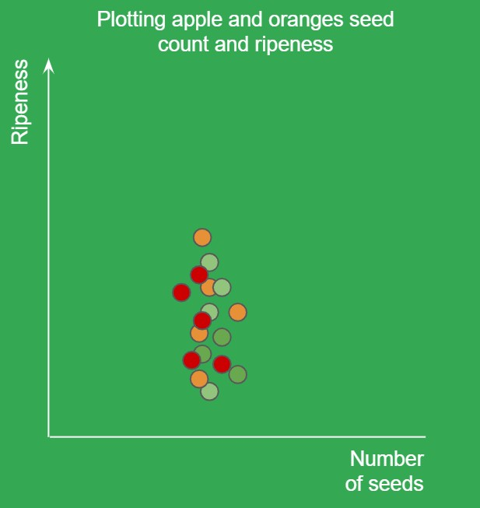
FEATURES / ATTRIBUTES
Choosing useful features can have a big impact on the quality of the ML system. Some features may not be useful enough to separate the data points.
In this example we take bad features of fruits(ripeness and seed count) that do not allow us to learn any distinguishing factors for the fruit.

Slide 41
WHAT ML CANNOT PREDICT STUFF IT DOESN’T
KNOW ABOUT
Lets say you teach an ML system about animals like this:
Number of Legs, Color,Weight, Animal:
4, Black, 10KG, Dog
2, Orange, 5KG, Chicken
If you now present it with a Cow: 4 legs, black, 200KG it would predict “Dog”. This is because it only knows about dogs and chickens and this was the closest match.

Slide 42
HOW ML SYSTEMS ARE TRAINED (LEARNING STYLE)

Slide 43
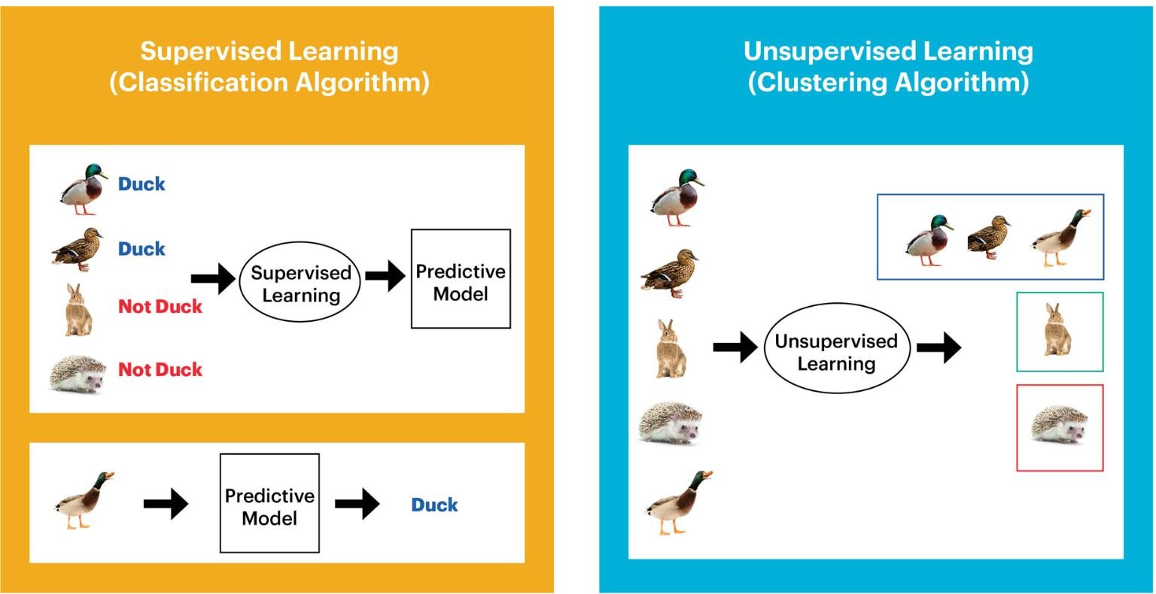
SUPERVISED VS UNSUPERVISED
43

Slide 44
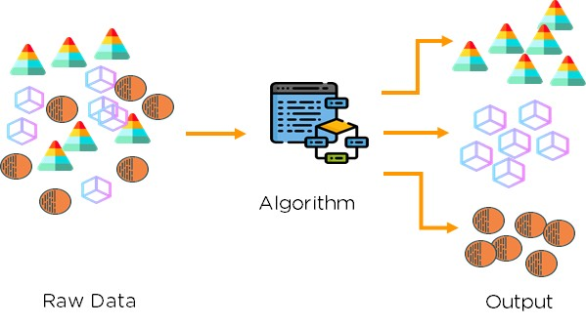
UNSUPERVISED LEARNING
Unsupervised learning model learns through observation and finds structures in the data.When the model is feed data, it automatically finds patterns and relationships in the data by creating clusters in it. What it cannot do is adding labels to the cluster. Like the picture shown below.

Slide 45
MACHINE LEARNING ALGORITHMS SUPERVISED
Regression Classification
Linear Regression • Linear Classifiers
Simple Linear Regression
Logistic Regression
K - Nearest Neighbors
Decision Trees
Random Forest
Support Vector Machines
Multi Linear Regression
Polynomial Regression
Polynomial Regression
Multi Polynomial Regression
By Anil Kumar APSSDC
45

Slide 46
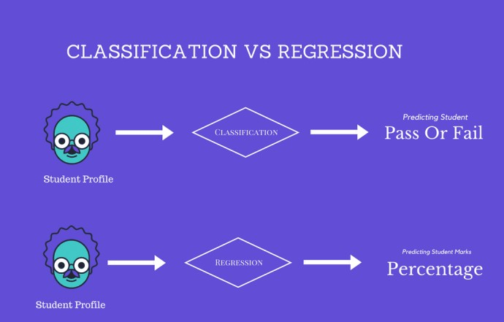
By Anil Kumar APSSDC
46

Slide 47
UNSUPERVISED
Clustering Types
Hierarchical clustering
K-means clustering
DBSCAN
Spectral clustering
Dimensionality Reduction
Principal Component Analysis
Independent Component Analysis
randomized SVD

Slide 48
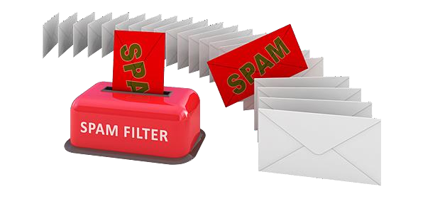
CLASSIFICATION

Slide 49


Slide 50

FRAUD DETECTION
By Anil Kumar APSS
DC
50

Slide 51
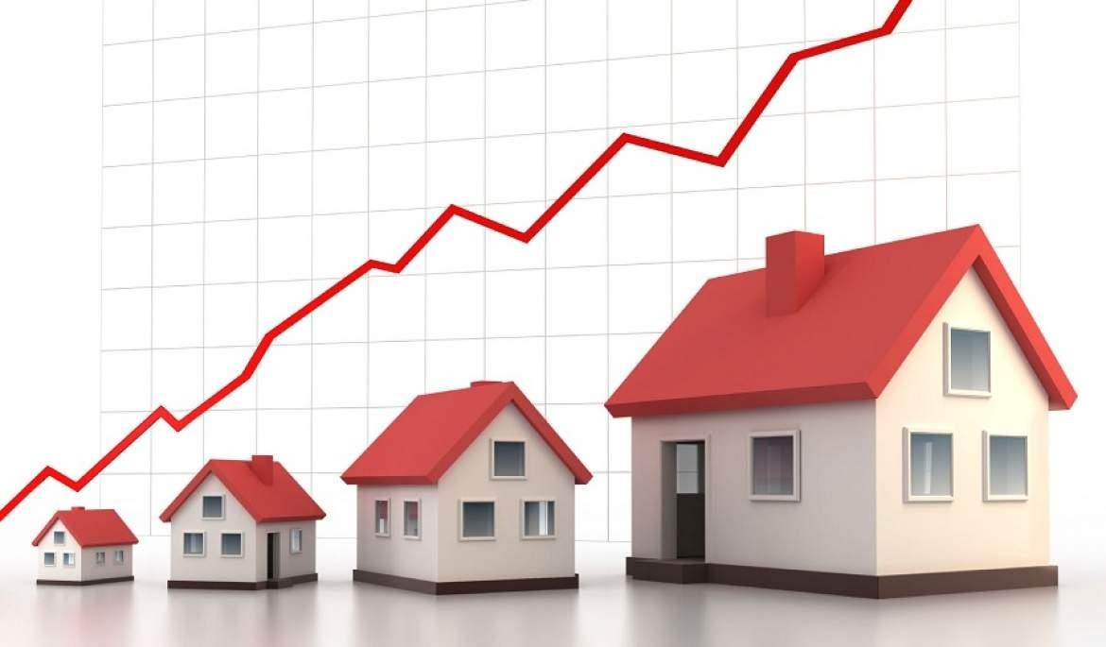
HOUSE PRICE PREDICTION
By Anil Kumar APSSDC

Slide 52
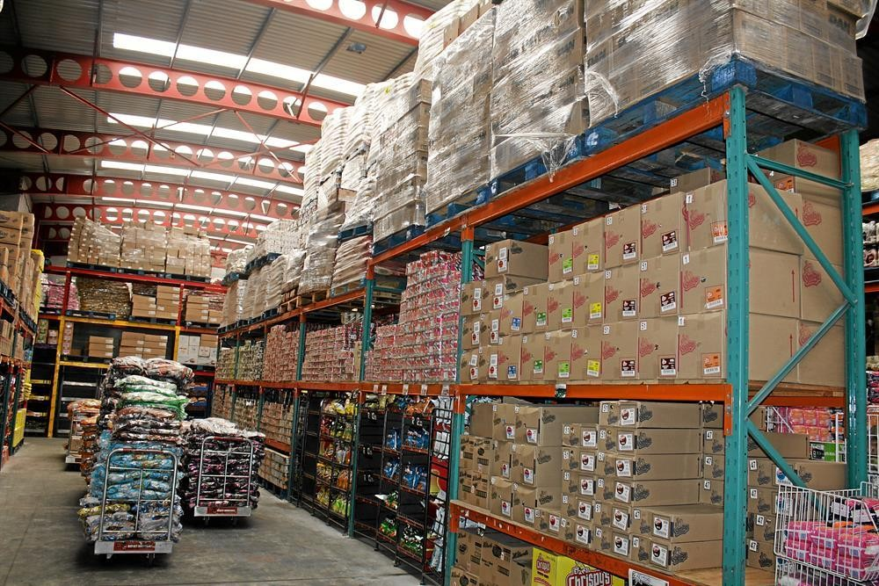
STOCK PREDICTION
By Anil Kumar APSSDC

Slide 53
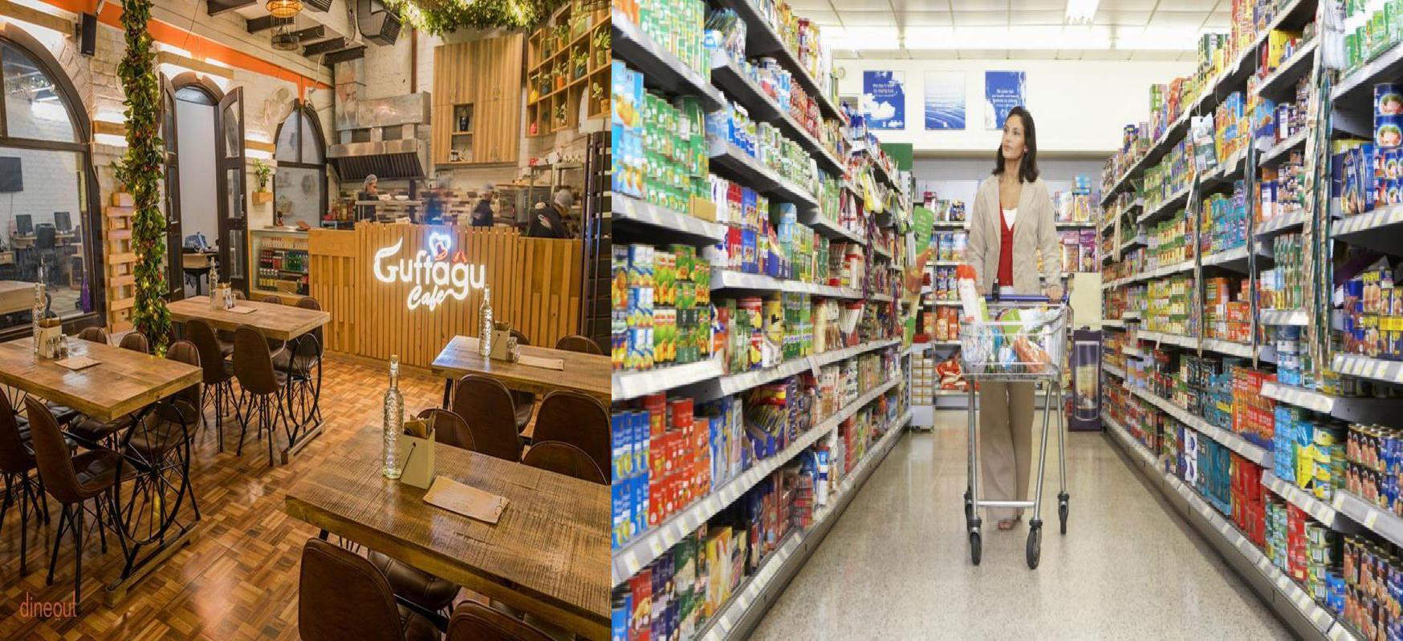
CUSTOMER PREDICTION

Slide 54
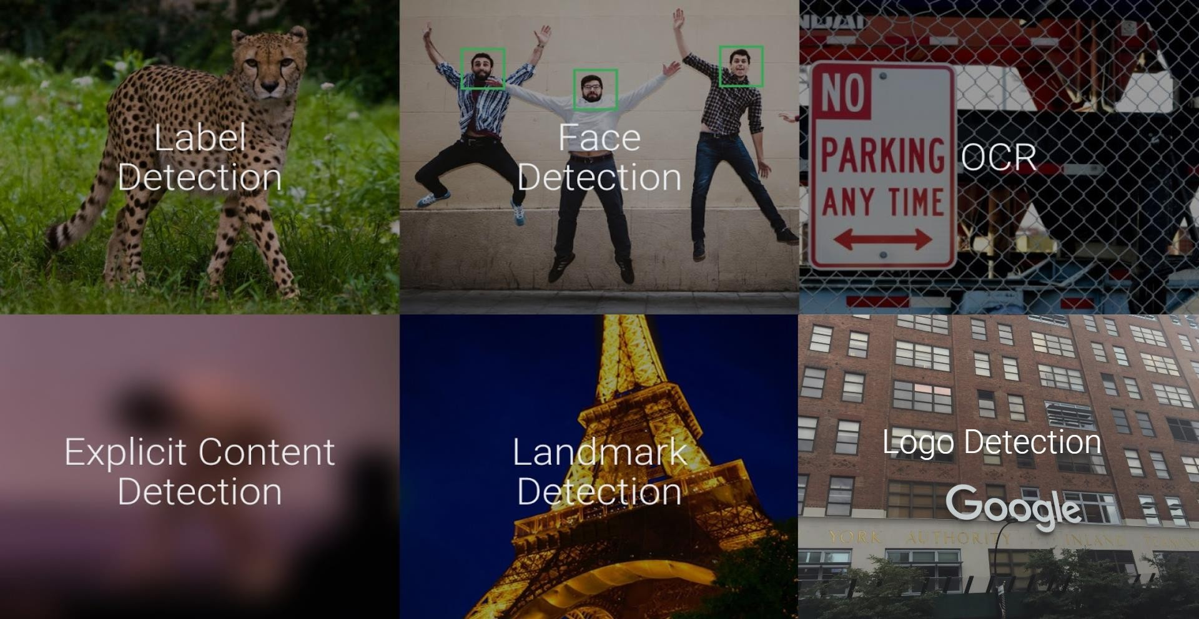

Slide 55
REFERENCES
Machine Learning in 45 minutes by Jason Mayes, Senior Creative Engineer at Google
Video: https://www.youtube.com/watch?v=X4I9QmcSEYo
Slides: https://goo.gl/fGJ8HJ

